Slide 1

Forecast
A new approach to identifying signs of students’ mental health and preventing school shootings

Slide 2
The Problem
Addressing student mental health

Slide 3
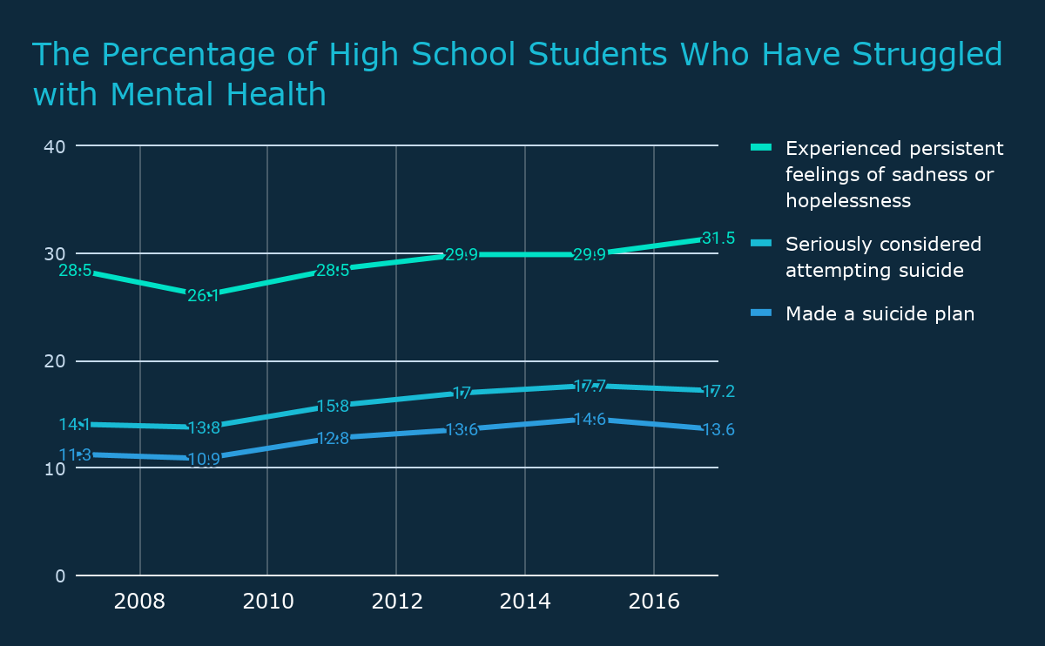
Student Mental Health
https://www.northcarolinahealthnews.org/2018/08/28/increasing-demand-for-mental-health-services-on-college-campuses/

Slide 4
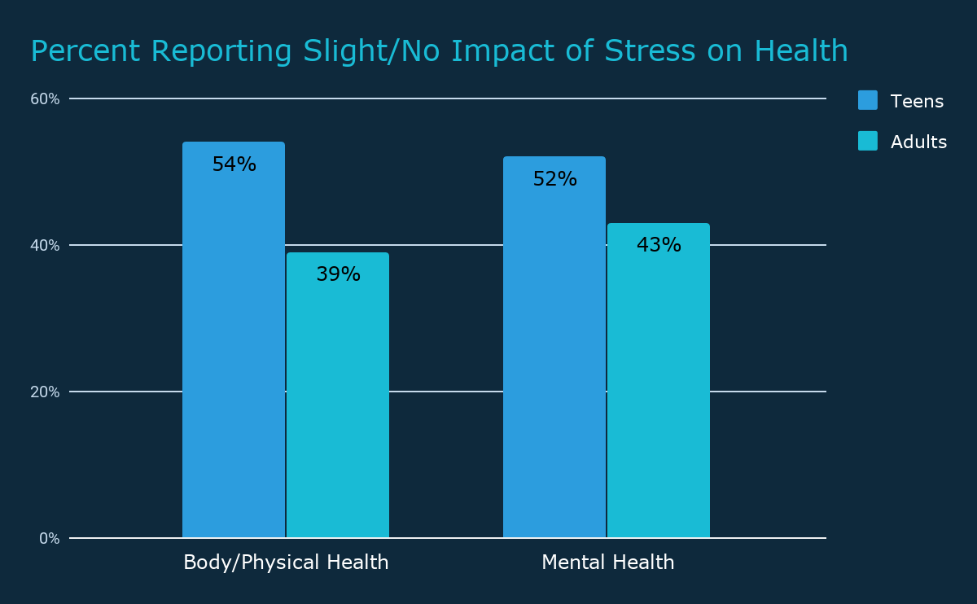
Student Mental Health
Stress in America: Are Teens Adopting Adults’ Stress Habits? (page 5)

Slide 5
Mental Illness Detection and Social Media Analysis can Prevent School Shootings
“Analysing the presence of school-shooting related communities at social media sites”
Semenov et. al
78% attempted suicide before
Leak plans through social media

Slide 6
Our Solution
How we solved the problem

Slide 7
Forecast
A service that provides school administration with easily missed mental health warning signs using students’ social media.

Slide 8
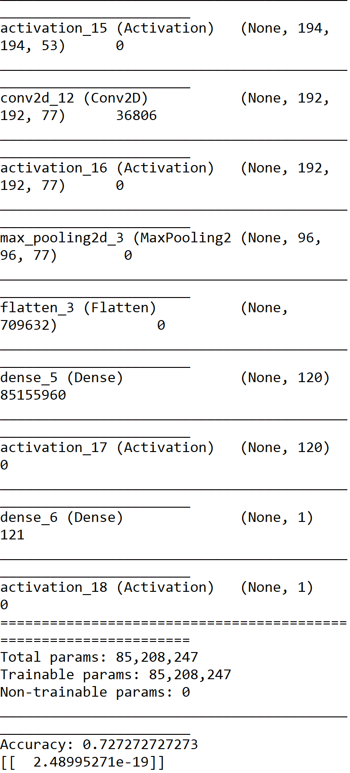

Gun Detection
Convolutional Neural Network
Detects presence of gun
Ex:

Slide 9
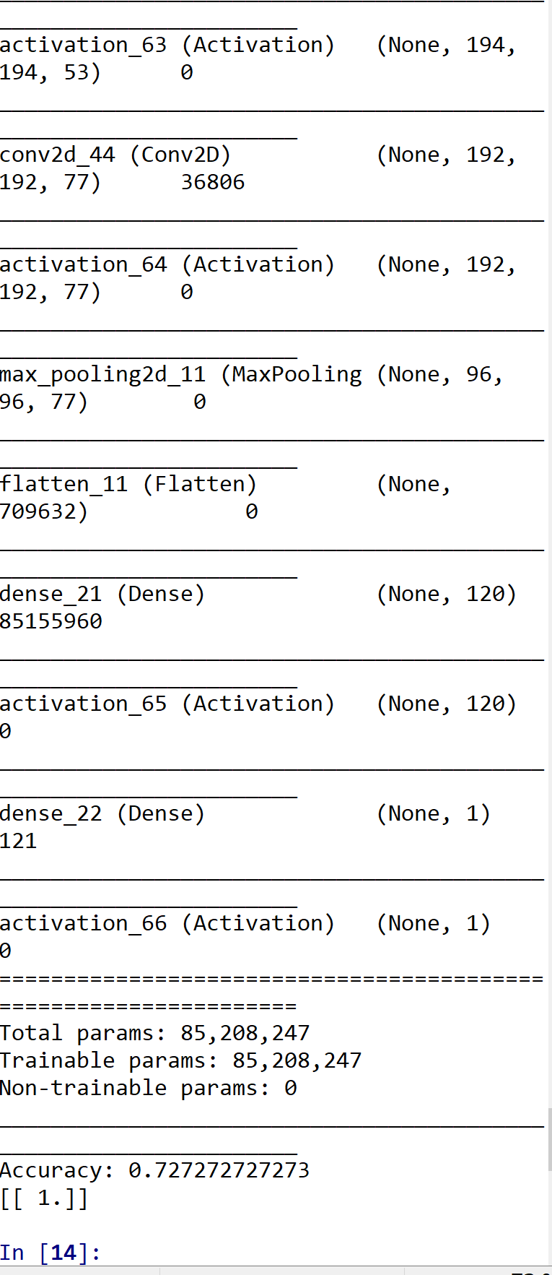


Slide 10

Details
4 Layers
Adam Optimization Algorithm
MaxPoolings
Conv2D
Future:
Even more data
Data Augmentation
YOLO Algorithm

